Slide 1
Regression Analysis and Gradient Descent

Slide 2
Several types of learning algorithms
Supervised learning
Teach the computer how to do something, then let it use it’s new found knowledge to do it.
Simply : y = f(x) i.e there always be y for each x.
Unsupervised learning
Let the computer learn how to do something, and use this to determine structure and patterns in data
Reinforcement learning
Recommender systems

Slide 3
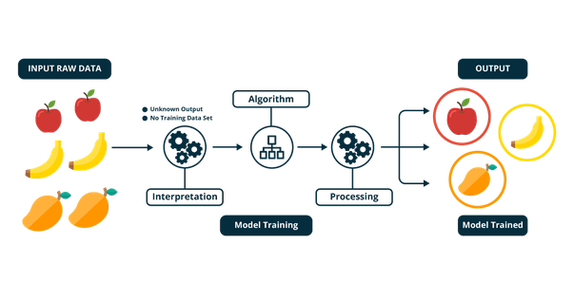

Slide 4
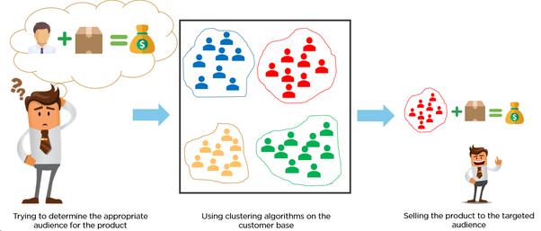
Unsupervised learning example

Slide 5
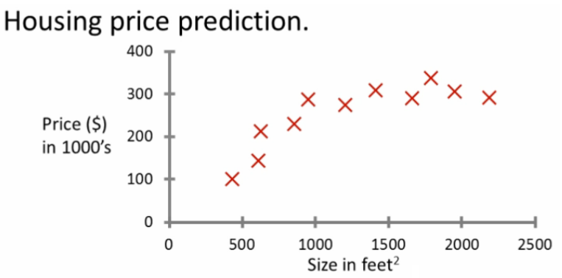
Supervised learning - introduction
Probably the most common problem type in machine learning
Starting with an example
How do we predict housing prices
Collect data regarding housing prices and how they relate to size in feet

Slide 6
SUPERVISED LEARNING Example problem
"Given this data, a friend has a house 750 square feet - how much can they be expected to get?“
What approaches can we use to solve this?
Straight line through data
Maybe $150 000
Second order polynomial
Maybe $200 000
One thing we discuss later - how to chose straight or curved line?
Each of these approaches represent a way of doing supervised learning

Slide 7
What does this mean?
We gave the algorithm a data set where a "right answer" was provided
So we know actual prices for houses
The idea is we can learn what makes the price a certain value from the training data
The algorithm should then produce more right answers based on new training data where we don't know the price already
i.e. predict the price
We also call this a regression problem
Predict continuous valued output (price)
No real discrete delineation

Slide 8
Linear Regression
Housing price data example used earlier
Supervised learning regression problem
What do we start with?
Training set (this is your data set)
Notation (used throughout)
m = number of training examples
x's = input variables / features
y's = output variable "target" variables
(x,y) - single training example
(x^{i}, y^{j}) - specific example (i^{th} training example)
i is an index to training set

Slide 9
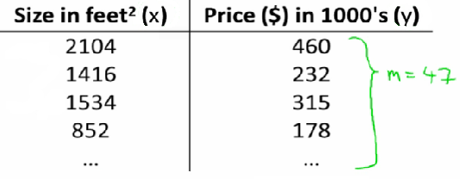

Linear Regression
With our training set defined - how do we used it?
Take training set
Pass into a learning algorithm
Algorithm outputs a function (denoted h ) (h = hypothesis)
This function takes an input (e.g. size of new house)
Tries to output the estimated value of Y
How do we represent hypothesis h ?
Going to present h as;
h_{θ}(x) = θ₀ + θ₁x
h(x) (shorthand)

Slide 10
Linear Regression
What does this mean?
Means Y is a linear function of x!
θ_{i} are parameters
θ₀ is zero condition
θ₁ is gradient
This kind of function is a linear regression with one variable
Also called univariate linear regression
So in summary
A hypothesis takes in some variable
Uses parameters determined by a learning system
Outputs a prediction based on that input

Slide 11
Linear regression - implementation (cost function)
A cost function lets us figure out how to fit the best straight line to our data
Choosing values for θ_{i} (parameters)
Different values give you different functions
If θ₀ is 1.5 and θ₁ is 0 then we get straight line parallel with X along 1.5 @ y
If θ₁ is > 0 then we get a positive slope
Based on our training set we want to generate parameters which make the straight line
Chosen these parameters so h_{θ}(x) is close to y for our training examples
Basically, uses xs in training set with h_{θ}(x) to give output which is as close to the actual y value as possible
Think of h_{θ}(x) as a "y imitator" - it tries to convert the x into y, and considering we already have y we can evaluate how well h_{θ}(x) does this.

Slide 12
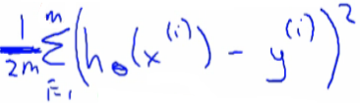
Linear regression - implementation (cost function)
To formalize this;
We want to want to solve a minimization problem
Minimize (h_{θ}(x) - y)²
i.e. minimize the difference between h(x) and y for each/any/every example
Sum this over the training set
Minimize squared different between predicted house price and actual house price1/2m
1/m - means we determine the average
1/2m the 2 makes the math a bit easier, and doesn't change the constants we determine at all (i.e. half the smallest value is still the smallest value!)
Minimizing θ₀/θ₁ means we get the values of θ₀ and θ₁ which find on average the minimal deviation of x from y when we use those parameters in our hypothesis function

Slide 13

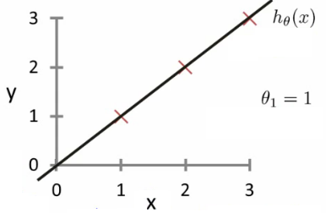
(cost function)
And we want to minimize this cost function
Our cost function is (because of the summation term) inherently looking at ALL the data in the training set at any time
So to recap:
Hypothesis - is like your prediction machine,
throw in an x value, get a putative y value.

Slide 14
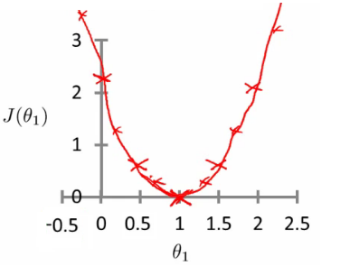
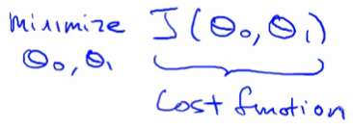
(cost function)
Cost - is a way to, using your training data, determine values for your θ values which make the hypothesis as accurate as possible.
-> This cost function is also called the squared error cost function
This cost function is reasonable choice for most regression functions
Probably most commonly used function
In case J(θ₀,θ₁) is a bit abstract, going into what it does, why it works and how we use it in the coming sections.

